Slide 1


micro:bit programming tutorial
Lesson 9
micro:bit basic lesson 9 “Handheld rangefinder”
Yahboom micro:bit tutorial

Slide 2
micro:bit programming tutorial
Part1
Part 2
Part3
Part 4
Learning goals
Preparation
Search for blocks
Combine blocks
Yahboom micro:bit tutorial

Slide 3
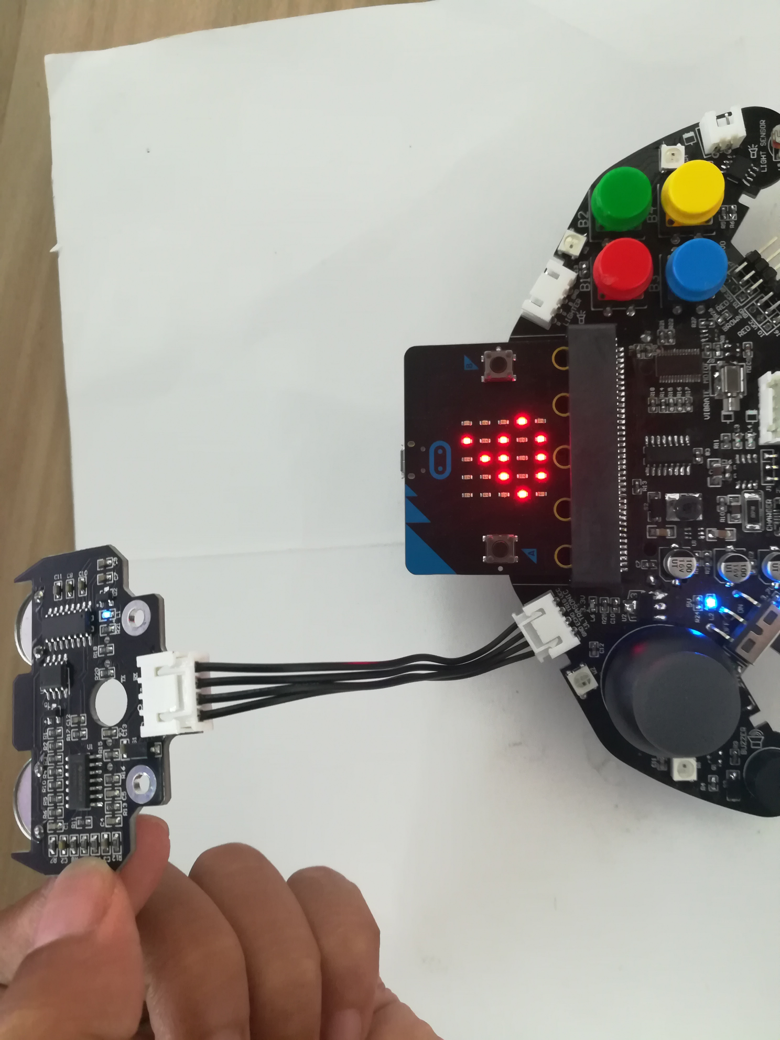
micro:bit programming tutorial
Part1
When the program is successfully downloaded, the LED screen will scroll to display the distance measured by the ultrasonic sensor.
Yahboom micro:bit tutorial

Slide 4
micro:bit programming tutorial
Part2
Hardware：
● 1 X micro:bit Game Handle
● 1 X Micro USB Cable
Yahboom micro:bit tutorial

Slide 5
micro:bit programming tutorial
Two programming methods
Part2
1.Online: Connect Micro:bit to the computer via USB cable, and the computer will pop up a U disk and click the URL in the U disk to enter the programming interface.Enter this URL https://github.com/yahboomtechnology/ghbitlib to get the package named GHBit.
2.offline：Open micro:bit offline programming software and add GHBit package.Click on "Advanced" and select "Add Package".Enter this URL https://github.com/yahboomtechnology/ghbitlib to get the package named GHBit.
Note: If you already have a GHBit package, you don't need to add it repeatedly.
Yahboom micro:bit tutorial

Slide 6
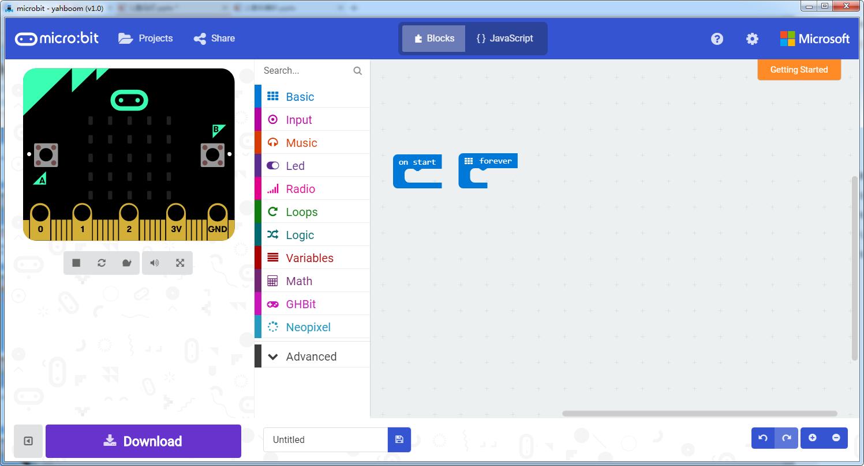
micro:bit programming tutorial
Programming interface
Part3
Yahboom micro:bit tutorial

Slide 7
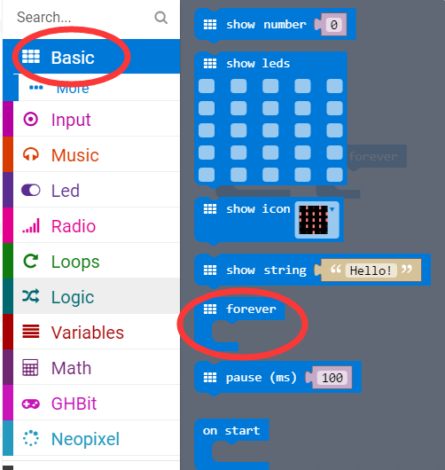
micro:bit programming tutorial
Part3
Start programming
The “forever” building block means that when the micro:bi Game Handle is turned on, the blocks in “forever” are repeatedly executed.
Yahboom micro:bit tutorial

Slide 8
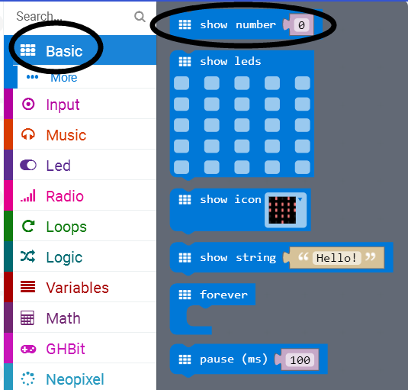
micro:bit programming tutorial
Part3
Scroll a number on the screen.If the number fits on the screen(i.e.is a single digit),do not scroll.
Yahboom micro:bit tutorial

Slide 9
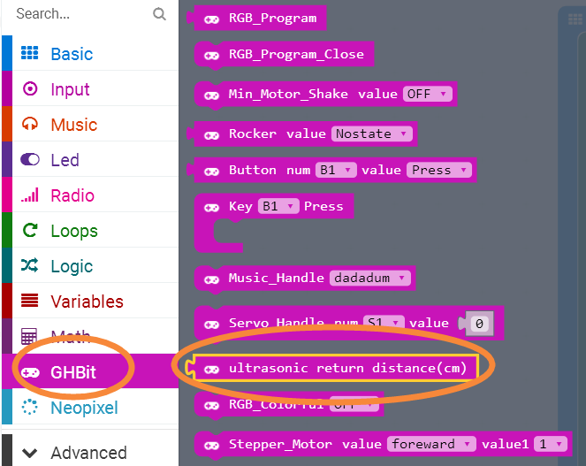
micro:bit programming tutorial
Part3
Get the distance detected by the ultrasonic sensor.
Yahboom micro:bit tutorial

Slide 10
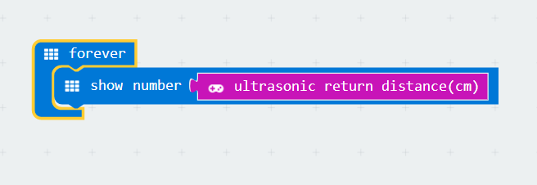
micro:bit programming tutorial
Part4
This is the complete building block for this course, let's download it to the micro:bit Game Handle.
!Note:
Ultrasonic ECHO uses the P11 pin of the micro:bit board, which is multiplexed with the A button pin on the micro:bit board. Therefore, when using the ultrasonic module, the B button cannot be used at the same time.
Yahboom micro:bit tutorial

Slide 11
micro:bit programming tutorial
micro:bit
Thanks for watching！
Yahboom
Yahboom micro:bit tutorial

